Slide 1
Lecture 8 Uninformed search
CS 180 – Intelligent Systems
Dr. Victor Chen
Fall 2022

Slide 2

Uninformed Search

Slide 3
Uninformed search
In uninformed search, we use only the information available in the problem definition
Breadth-first search
Depth-first search
Iterative deepening search
Uniform-cost search

Slide 4
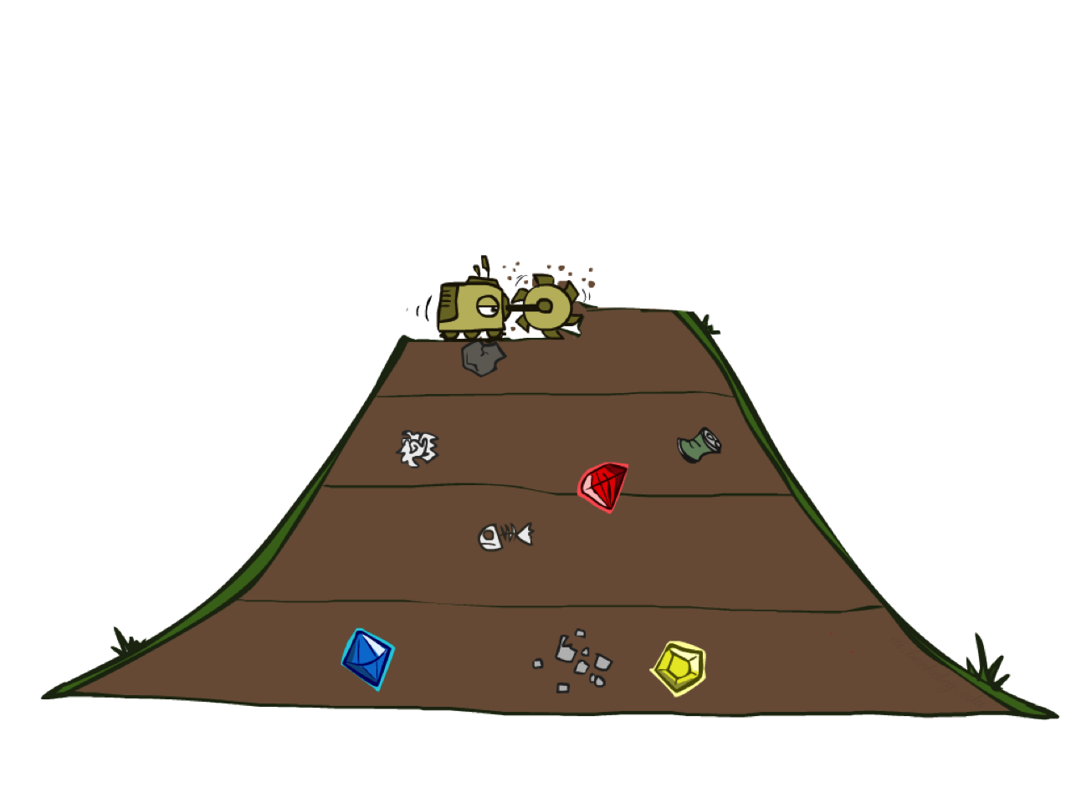
Breadth-First Search

Slide 5
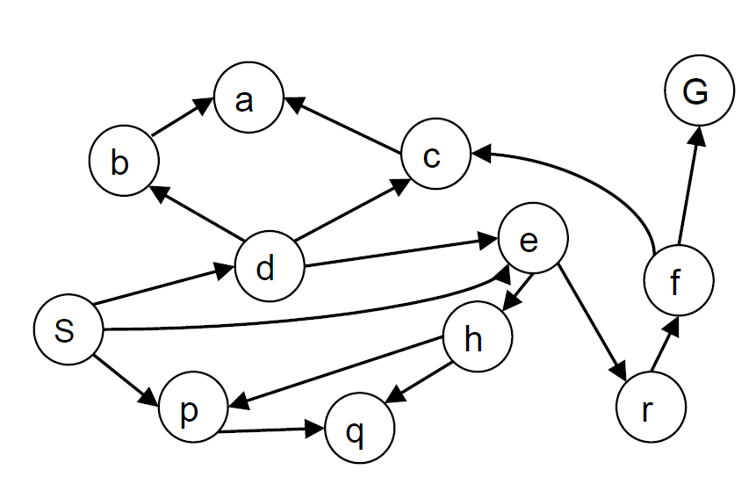
Breadth-First Search
Expand shallowest unexpanded node
Basic idea: visit all your neighbors before your neighbor's neighbors
Implementation: frontier is a FIFO queue
State space graph for a search problem

Slide 6
Breadth-First Search
Strategy: expand a shallowest node first
Implementation: Frontier is a FIFO queue
a
G
b
c
State space graph
d
e
f
S
h
p
q
r
S
d
e
p
Search
Tiers
b
c
e
h
r
q
Search tree
a
a
h
r
p
q
f
p
q
f
q
c
G
q
c
G
a
a

Slide 7
Breadth-First Search (BFS) Cost
What nodes does BFS expand?
Expand all nodes above shallowest solution
Let depth of shallowest solution be d
Search takes time O(b^{d}), where b is maximum branching factor of the search tree
How much space does the frontier take?
Has roughly the last tier, so O(b^{d})
1 node
b
…
b nodes
d tiers
b² nodes
b^{d} nodes
b^{m} nodes

Slide 8
Properties of breadth-first search
Complete?
If a solution exists, BFS will find it. So yes!
Optimal?
Yes, only if costs are all 1
Time cost?
O(b^{d})
(b: maximum branching factor and d is the depth of the optimal solution)
Space cost?
O(b^{d})

Slide 9
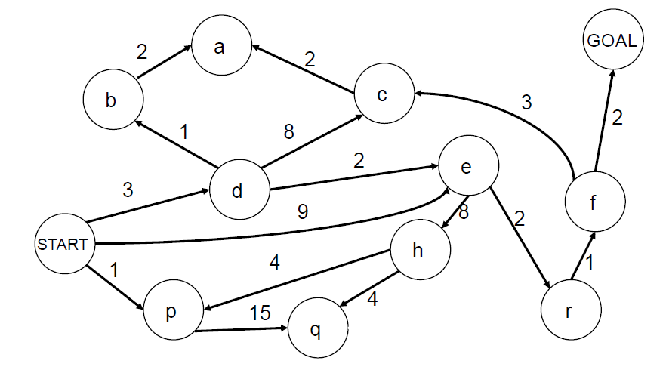
BFS optimal? Yes but only if cost = 1 per step
BFS finds the solution with the fewest steps, but does not always find the shortest path (optimal solution)

Slide 10
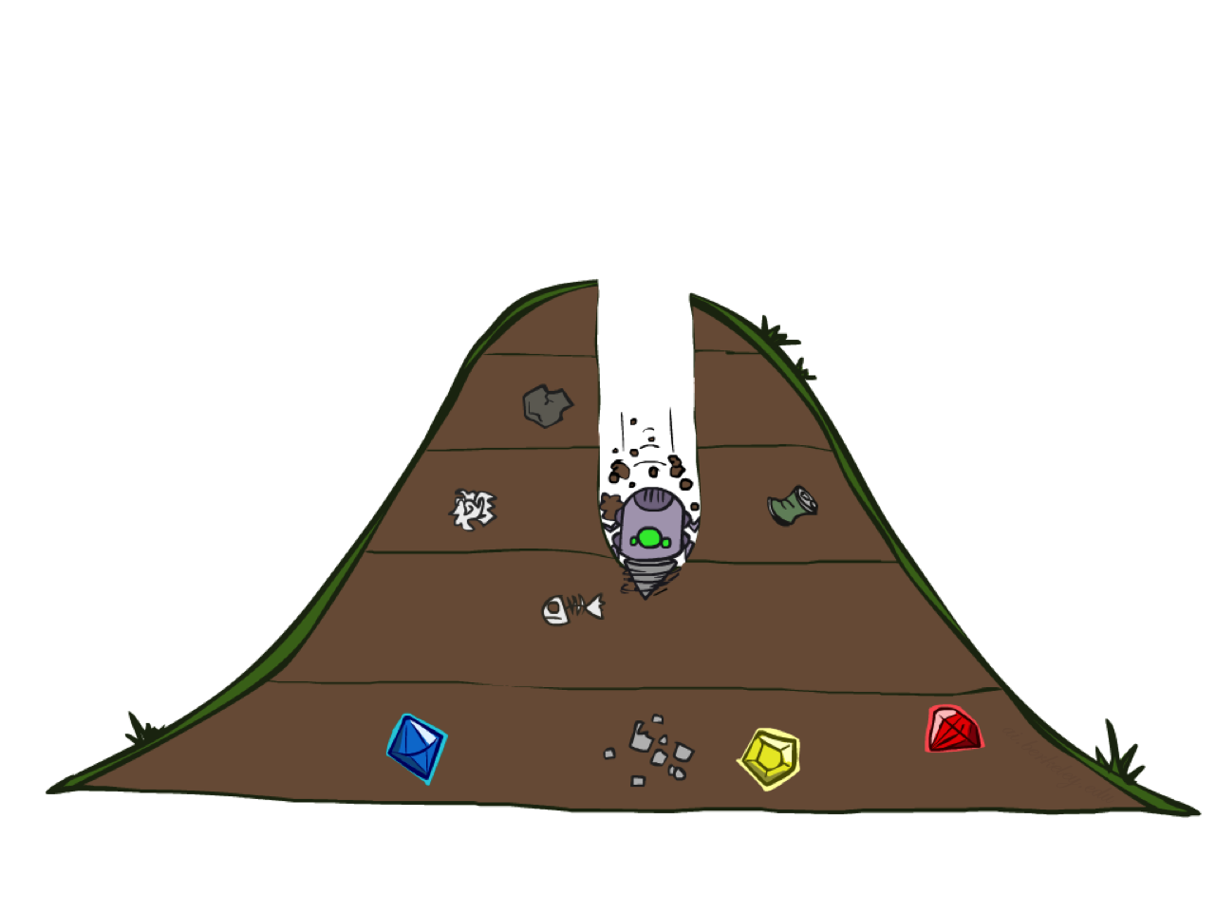
Depth-first search

Slide 11
Depth-first search
Expand deepest unexpanded node
Basic idea: visit nodes adjacent to the last visited node first
Implementation: frontier is a LIFO queue (a stack)

Slide 12
Depth-First Search
Strategy: expand a deepest node first
Implementation: Frontier is a LIFO stack
a
G
a
c
b
c
b
e
d
e
d
f
f
S
h
h
p
p
r
q
r
q
S
d
e
p
b
c
e
h
r
q
a
a
h
r
p
q
f
p
q
f
q
c
G
q
c
G
a
a

Slide 13
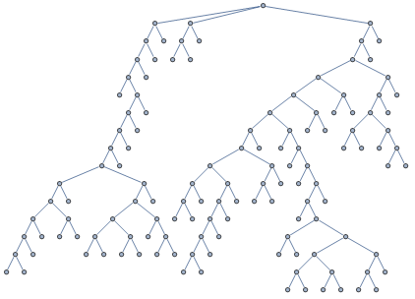
BFS vs. DFS

Slide 14
BFS vs. DFS

Slide 15
BFS vs. DFS

Slide 16
BFS vs. DFS

Slide 17
BFS vs. DFS

Slide 18
BFS vs. DFS

Slide 19
BFS vs. DFS

Slide 20
BFS vs. DFS

Slide 21
BFS vs. DFS

Slide 22
BFS vs. DFS

Slide 23
BFS vs. DFS

Slide 24
BFS vs. DFS

Slide 25
BFS vs. DFS

Slide 26
BFS vs. DFS

Slide 27
BFS vs. DFS

Slide 28
BFS vs. DFS

Slide 29
BFS vs. DFS

Slide 30
BFS vs. DFS

Slide 31
BFS vs. DFS

Slide 32
BFS vs. DFS

Slide 33
BFS vs. DFS

Slide 34
BFS vs. DFS

Slide 35
Properties of depth-first search
Complete?
Fails in infinite-depth tree, or states with loops
Optimal?
No – returns the first solution it finds
Time cost?
Worst case: O(b^{m}) (b: maximum branching factor and m is the depth of entire search tree)
Comparison with BFS:
O(b^{d}) (d is the depth of the optimal solution)
Terrible since m >> d!
But if there are lots of solutions, DFS may be much faster than BFS
Space cost?
O(bm), i.e., linear cost!

Slide 36

Demo Maze BFS

Slide 37
Demo Maze DFS

Slide 38
Can we have a search strategy that is optimal like BFS and also efficient like DFS?

Slide 39
Iterative deepening search (IDS)
Use DFS as a subroutine
Check the root
Do a DFS search for a solution of length 1
If there is no solution of length 1, do a DFS search for a solution of length 2
If there is no solution of length 2, do a DFS search for a solution of length 3…

Slide 40
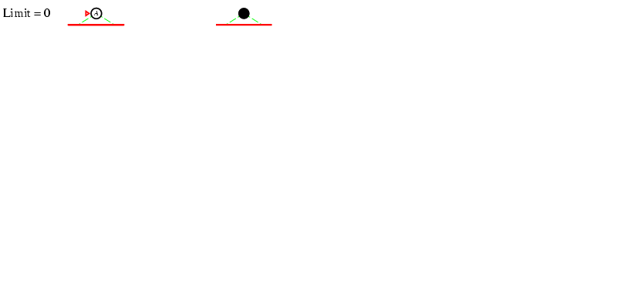
Iterative deepening search

Slide 41
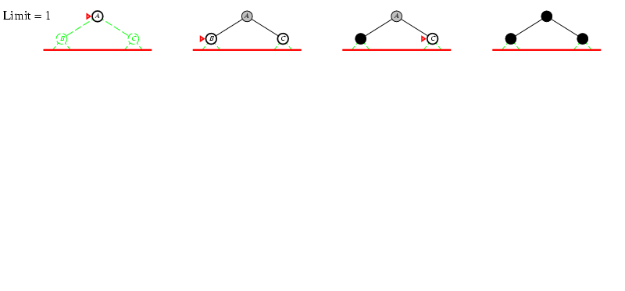
Iterative deepening search

Slide 42
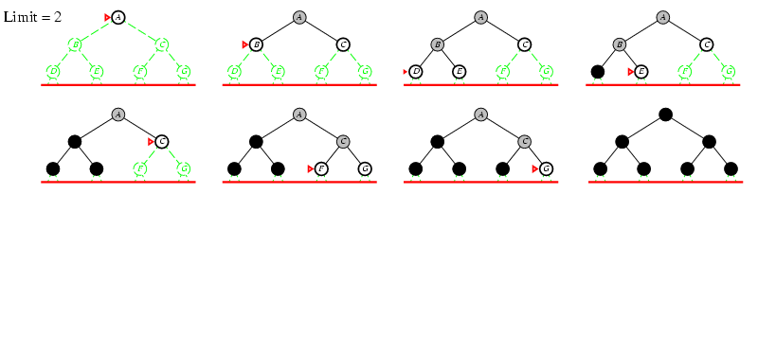
Iterative deepening search

Slide 43
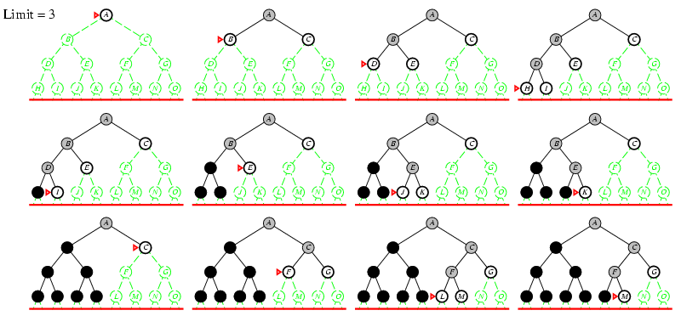
Iterative deepening search

Slide 44
Properties of iterative deepening search
Complete?
Yes
Optimal?
Yes, if step cost = 1
Time cost?
O(b^{d}) (d is the depth of the optimal solution)
Like BFS
Space cost?
O(bd)
Linear cost (even better than DFS)

Slide 45
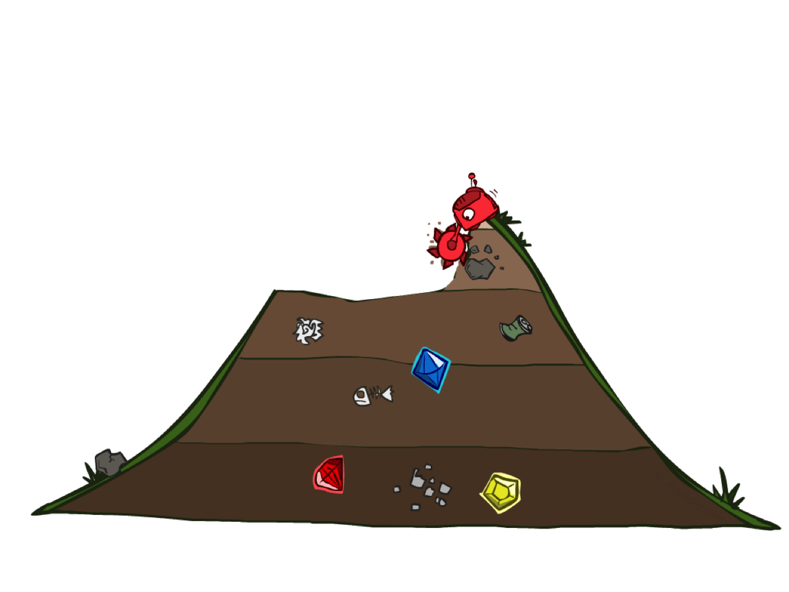
Uniform Cost Search

Slide 46
Uniform-cost search
Rank all the nodes on g(n), the cost from initial state to n, and expand the node with the lowest g(n)
Implementation: frontier is a priority queue ordered by g(n)

Slide 47
Uniform-cost search example
2
G
Strategy: expand a cheapest node first:
Frontier is a priority queue (priority: g-value (cumulative cost))
a
b
1
8
c
2
2
3
d
e
f
9
8
2
S
h
1
1
p
q
r
15
0
S
d
3
e
9
p
1
b
4
e
5
h
17
r
11
q
16
c
11
a
6
a
h
13
r
7
p
q
f
p
q
f
8
q
c
G
q
c
a
11
G
10
a

Slide 48
UCS vs BFS
BFS is a special case of UCS when all step costs are equal

Slide 49
UCS == Dijkstra's algorithm
UCS is equivalent to Dijkstra's algorithm except that Dijkstra's algorithm is used to find shortest paths from initial node to every other nodes in a graph, whereas UCS is only used to find the shortest path from initial node to a goal node.

Slide 50
Uniform Cost Search (UCS) Properties
Is it complete?
Yes!
Is it optimal?
Yes!
Time and space cost?
Expand all nodes with cost less than optimal solution (g(n) ≤ C*)

Slide 51
Pros and cons of uniform cost search
The good: UCS is complete and optimal!
The bad:
Explores nodes in every “direction”
Expensive

Slide 52
Uniform-cost search

Slide 53
Review: Uninformed search strategies
Algorithm | Complete? | Optimal? | Time complexity | Space complexity
BFS
DFS
IDS
UCS
Yes
If all step costs are equal
O(b^{d})
O(b^{d})
No
No
O(b^{m})
O(bm)
Yes
If all step costs are equal
O(b^{d})
O(bd)
Yes
Yes
Number of nodes with g(n) ≤ C*
b: maximum branching factor of the search tree
d: depth of the optimal solution
m: maximum length of any path in the search tree
C*: cost of optimal solution
g(n): cost of path from initial state to node n

Slide 54
How to choose between uninformed search strategies
Uniform Cost Search will reach the goal in the cheapest way possible.
Breadth-First Search will reach the goal in the shortest way possible.
Depth-First Search is not optimal but it may run much faster when multiple solutions exists.
Iterative deepening search (IDS) mixed BFS with DFS

Slide 55

The One Queue for All Strategies
All search algorithms are the same except for frontier strategies
Conceptually, all frontiers are priority queues.
Practically, for DFS and BFS, you can avoid the overhead from an priority queue by using stacks and queues

Slide 56
Recap: All search strategies so far…
Algorithm | Complete? | Optimal? | Time complexity | Space complexity
BFS
DFS
IDS
UCS
Greedy
A*
Yes
If all step costs are equal
O(b^{d})
O(b^{d})
No
No
O(b^{m})
O(bm)
Yes
If all step costs are equal
O(b^{d})
O(bd)
Yes
Yes
Number of nodes with g(n) ≤ C*
Worst case: O(b^{m})
No
No
Best case: O(bd)
Yes (if heuristic is
admissible)
Yes
Number of nodes with g(n)+h(n) ≤ C*

Slide 57
More demos
http://qiao.github.io/PathFinding.js/visual/
http://bryukh.com/labyrinth-algorithms/

